Slide 1
CIS 11 – Computer Architecture
James Wilson

Slide 2
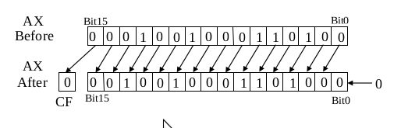
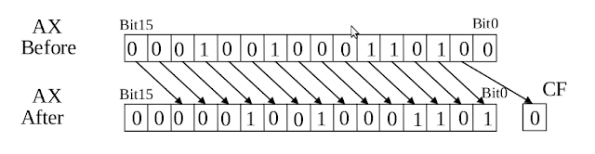
Bit Shifting
Logical

Slide 3
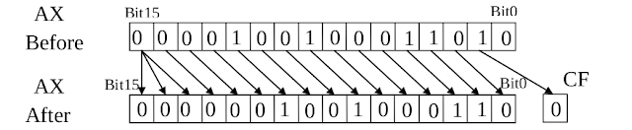
Bit Shifting
Arithmetic

Slide 4
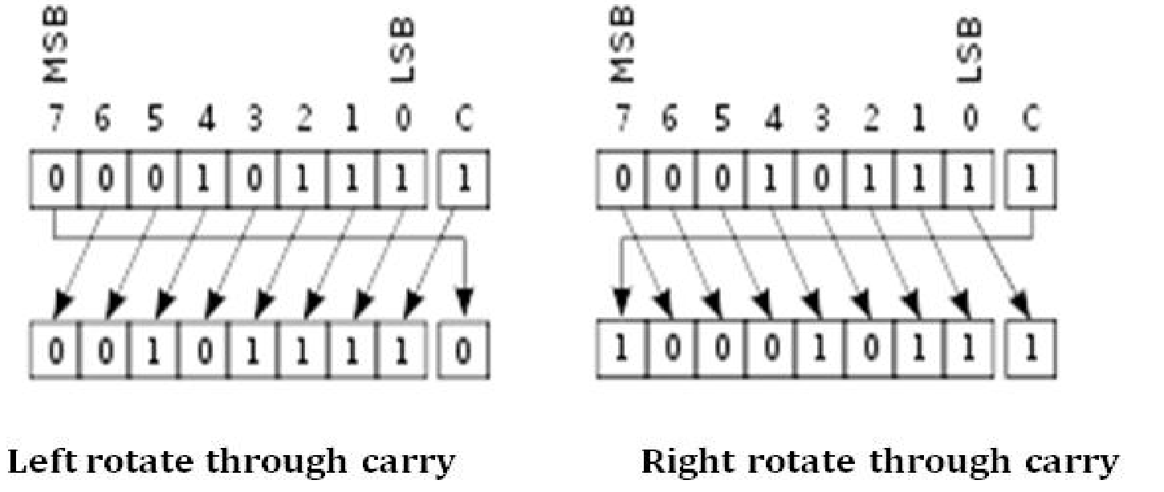
Bitwise Rotation
Rotate with Carry Flag (CF)

Slide 5
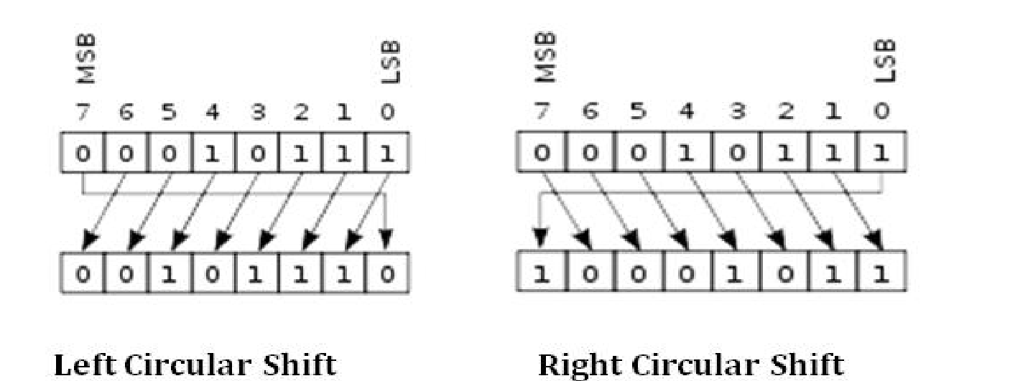
Bitwise Rotation
Circular Rotation (no CF)

Slide 6
Multiplication & Division
MUL
IMUL
DIV
IDIV

